Slide 1
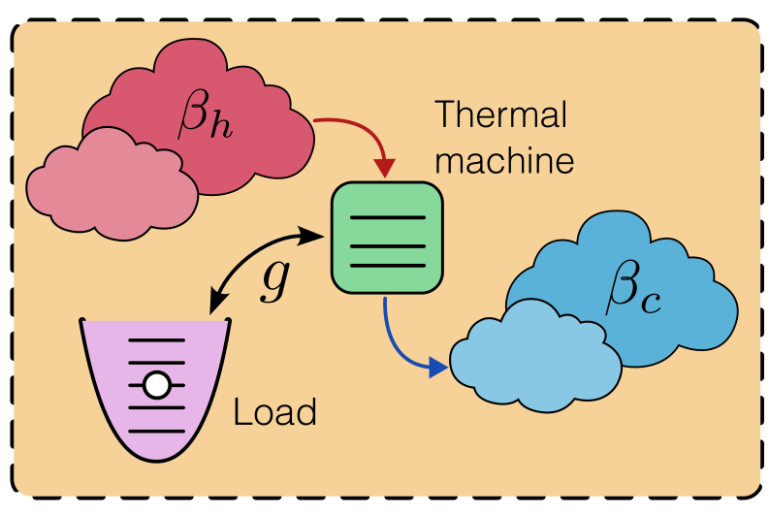




Quantum Thermal Machines And The Emergence Of Different Thermodynamic Functioning Regimes From Finite Coupling To A Load
Gauthameshwar S. , Noufal Jaseem, Dario Poletti

Slide 2
Table Of Contents
Concept and motivation
Overview: Quantum thermal machines.
Why autonomous machines?
Three-level engine: The semi-classical vs autonomous picture.
Core results
The four thermal operation modes.
Finite coupling → new operation regimes.
Bosonic load back-action.
Experimental platforms to construct the device
Three-level engine and implementation.
Two-qubit engine and implementation.
Summary and outlook

Slide 3
What Are Quantum Thermal Machines
Work

Slide 4
What Are Quantum Thermal Machines
Thermal
Machines
Work

Slide 5
What Are Quantum Thermal Machines
Quantum
Thermal
Machines
Work
Heat currents: Bath’s Lindbladian term.
Work: Two-point measurements, ergotropy.
Temperature: Set by Gibbs thermal state.

Slide 6
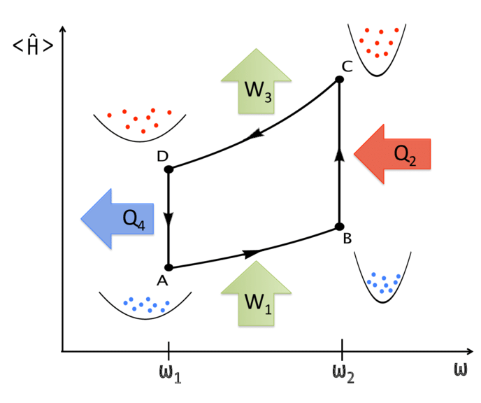

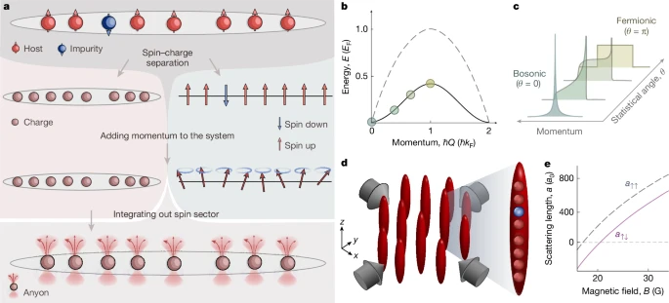

Types Of Quantum Thermal Machines
Periodically Driven Quantum Thermal Machines
Single/multiple qubits
Pros:
Intuitive link to classical thermodynamics.
Analytic solutions possible in simplified models.
Cons:
Approximates interaction with the load and the baths.
Not robust to noise.
1D bosonic/spin chains
Single/multiple
harmonic oscillators
An Otto cycle implemented in a
many-particle quantum heat engine
Zheng & Poletti, Phys. Rev. E 92, 012110 (2015)
Beau, M., Jaramillo, J. D., & del Campo, A. (2016). Scaling-up quantum heat engines efficiently via shortcuts to adiabaticity. Entropy, 18(5), 168.
Image source: https://doi.org/10.1038/s41586-025-09016-9

Slide 7
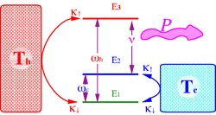
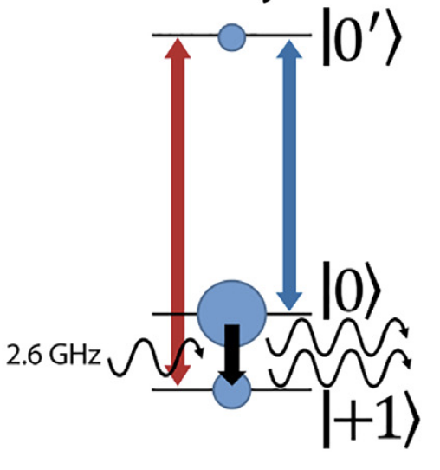
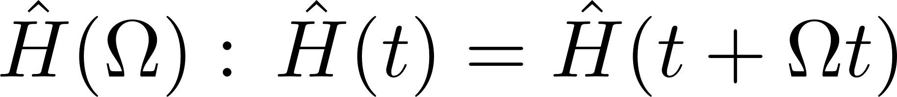
Types Of Quantum Thermal Machines
Continuously Driven Quantum Thermal Machines
Two/multiple qubits
Pros:
Closer to real physical processes
No need to engineer strokes.
Cons:
Semi-classical approximation of the work.
NV-centers
A three-level quantum heat engine with periodic driving that enhances output power P.
Multiple harmonic
oscillators
Kosloff, R., & Levy, A. (2014). Quantum Heat Engines and Refrigerators: Continuous Devices. Annual Review of Physical Chemistry, 65, 365–393.
Klatzow, J. et al. (2019). Experimental demonstration of quantum effects in the operation of microscopic heat engines. Physical Review Letters, 122, 110601.

Slide 8
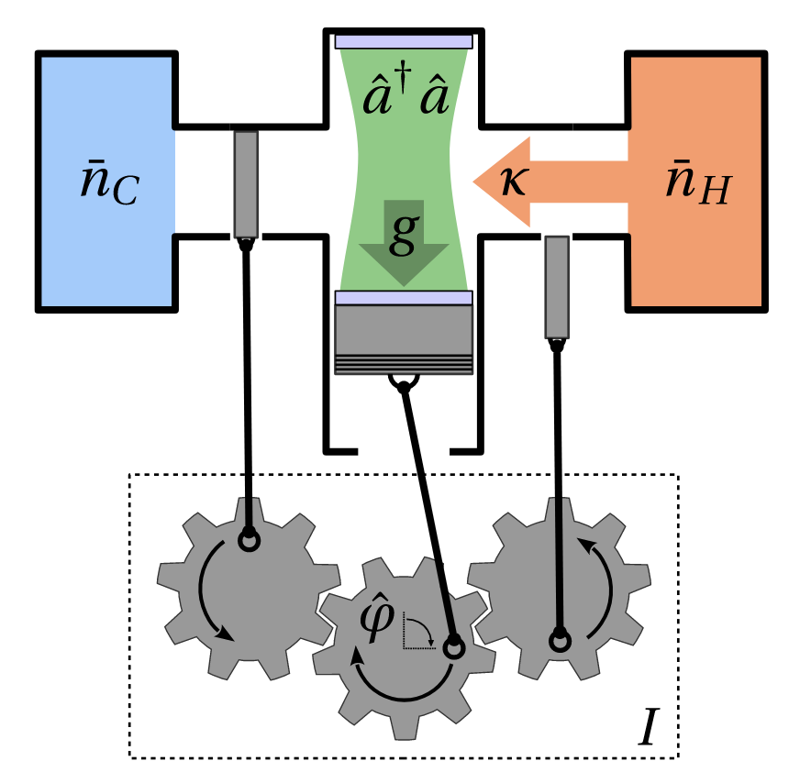
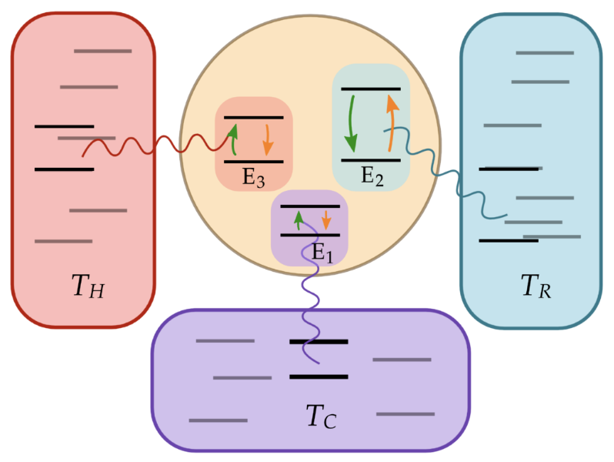
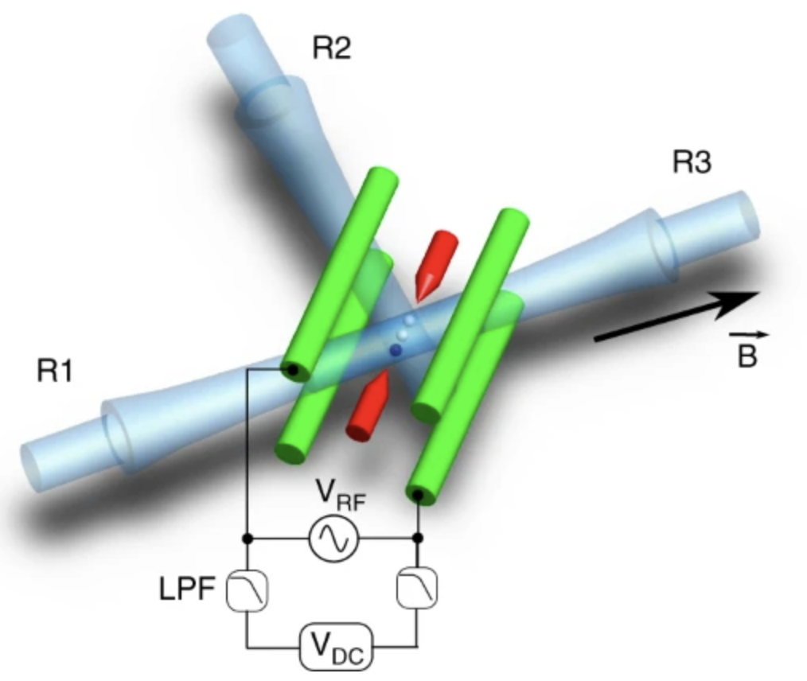
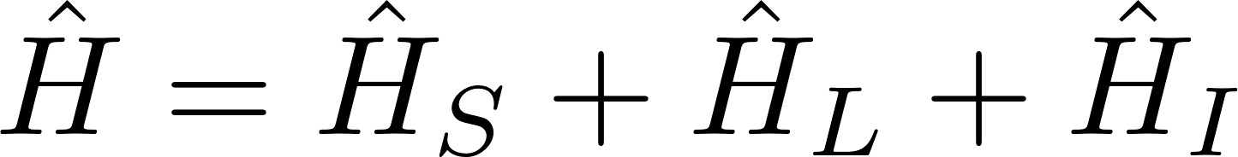
Types Of Quantum Thermal Machines
Autonomous Quantum Thermal Machines
Qubits with three-body interaction
Pros:
No external driving.
Cons:
Need to rely on numerical methods to study these systems.
An autonomous rotor engine with a Hamiltonian for the engine, the load, and the interaction.
Trapped ions with three-body interaction
Roulet et al., Autonomous rotor heat engine, Phys. Rev. E 95, 062131 (2017)
Maslennikov et al., Nat. Commun. 10, 202 (2019)

Slide 9
Why Autonomous Machines?
Continuous, self-contained,
and time-independent.
Backaction of the load is naturally included.
Minimal external control—reduces experimental complexity

Slide 10
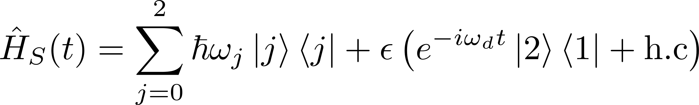
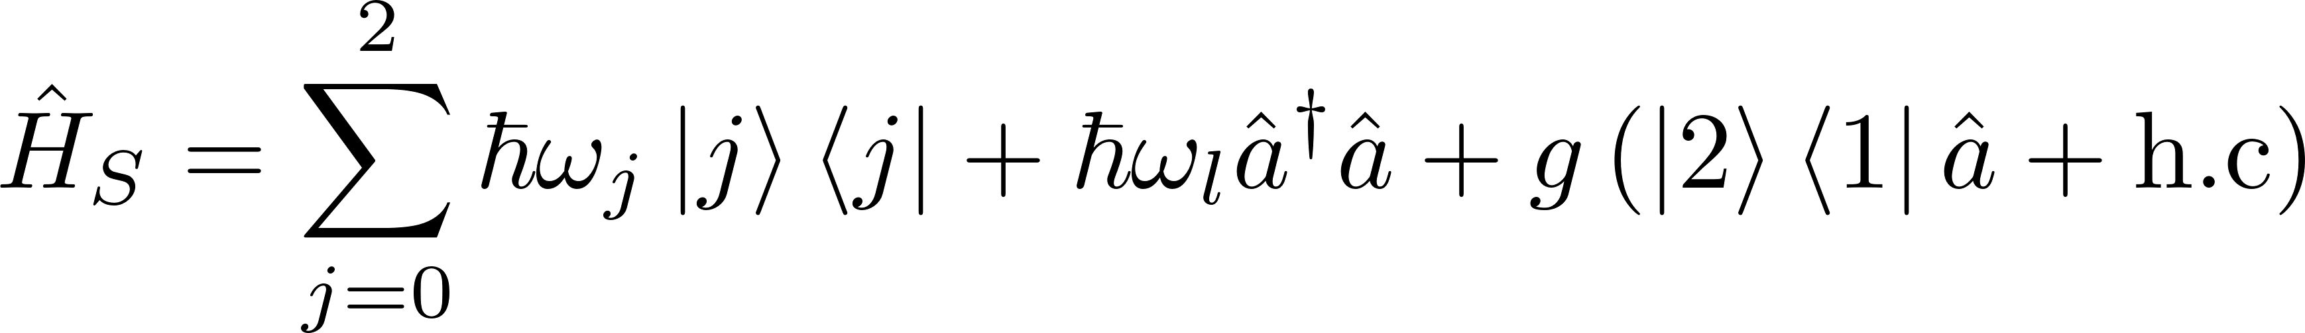
Three-level System: Semi-classical Vs Autonomous
Geva, E., & Kosloff, R. (1994). Three-level quantum amplifier as a heat engine: A study in finite-time thermodynamics. Phys. Rev. E, 49(5), 3903.

Slide 11
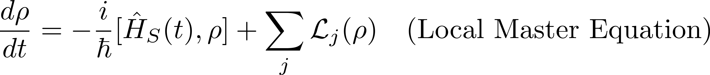
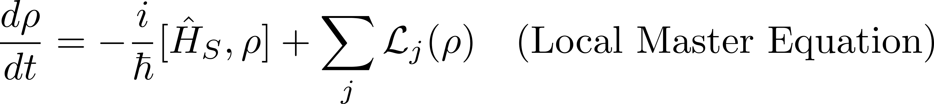
Three-level System: Semi-classical Vs Autonomous

Slide 12
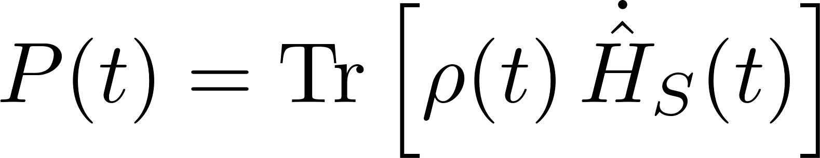
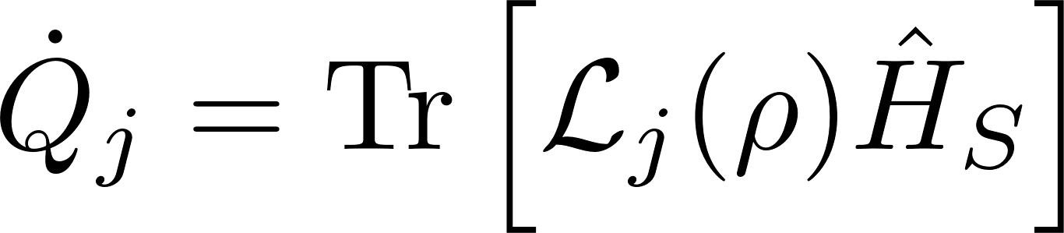
Three-level System: Semi-classical Vs Autonomous

Slide 13

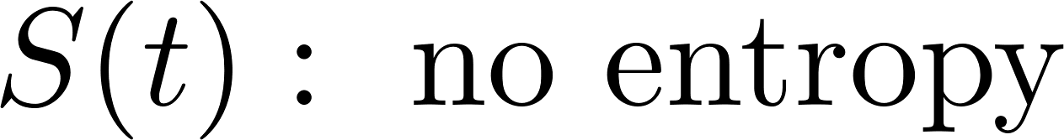
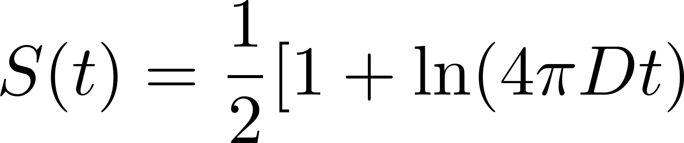
Three-level System: Semi-classical Vs Autonomous
Biased diffusion in the load: v, D

Slide 14
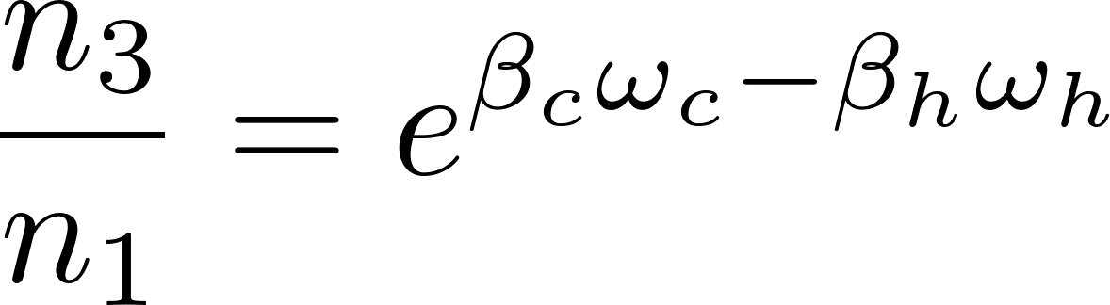
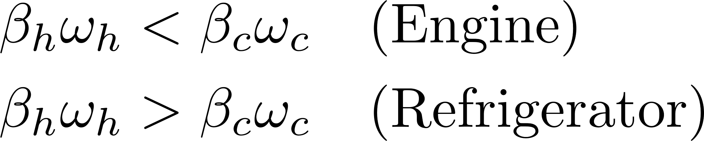
Three-level System: Semi-classical Vs Autonomous
Scovil, H. E. D., & Schulz-DuBois, E. O. (1959). Three-level masers as heat engines. Phys. Rev. Lett., 2(6), 262.

Slide 15
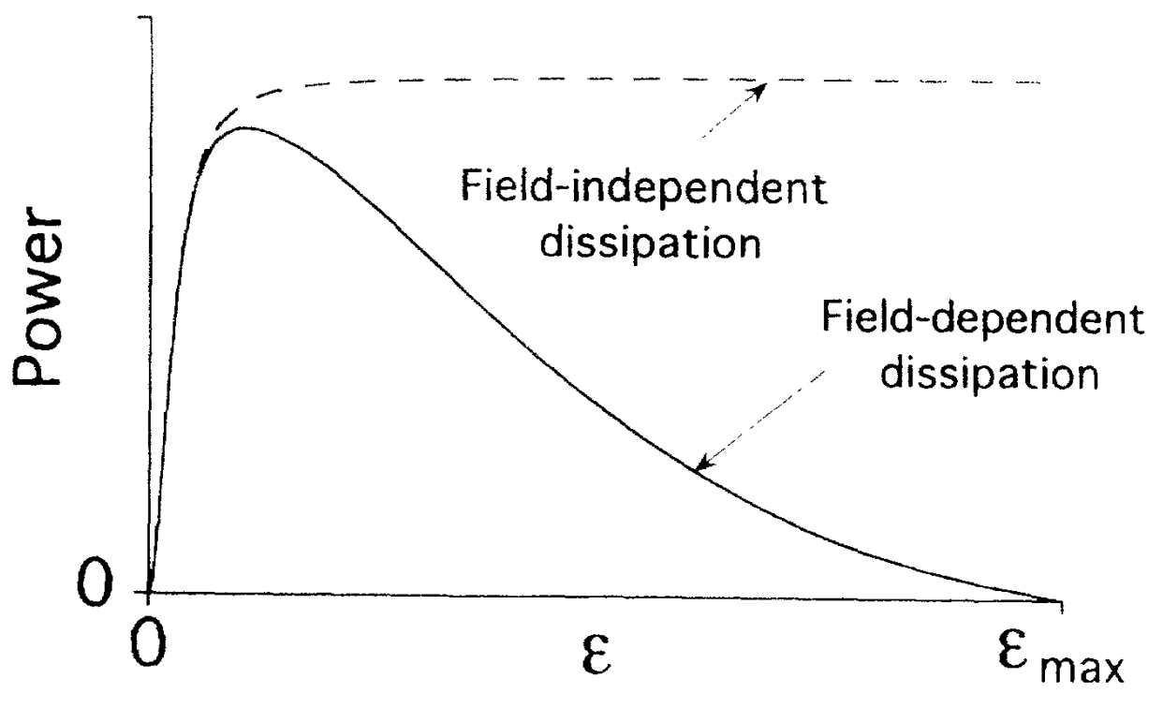
Three-level System: Semi-classical Vs Autonomous
Geva, E., & Kosloff, R. (1994). Three-level quantum amplifier as a heat engine: A study in finite-time thermodynamics. Phys. Rev. E, 49(5), 3903.

Slide 17
g
Finite coupling physics:
Four regimes of thermal operation
g’
Load back-action physics:
Load’s initial state affects the coupling strength

Slide 18
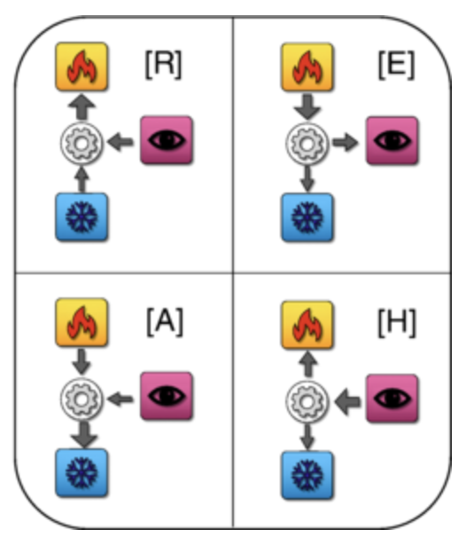
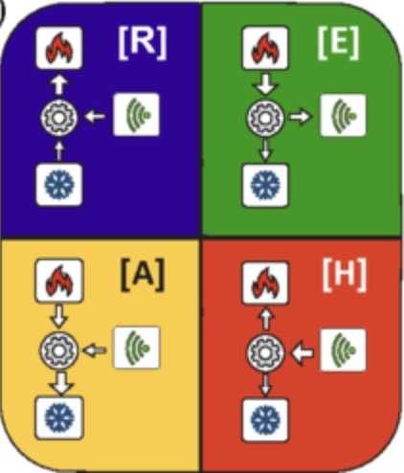
The Four Thermal Operation Modes
First observed in quantum
measurement cooling
The only four operation of quantum thermal machines coupled to two baths
Refrigerator [R] Engine [E]
Accelerator [A] Heater [H]
Lorenzo Buffoni, Andrea Solfanelli, Paola Verrucchi, Alessandro Cuccoli, and Michele Campisi Quantum Measurement Cooling Phys. Rev. Lett. 122, 070603 (2019)
Andrea Solfanelli, Marco Falsetti, and Michele Campisi Nonadiabatic single-qubit quantum Otto engine Phys. Rev. B 101, 054513 (2020)

Slide 19
The Four Thermal Operation Modes
First observed in quantum
measurement cooling
The only four operation of quantum thermal machines coupled to two baths
Lorenzo Buffoni, Andrea Solfanelli, Paola Verrucchi, Alessandro Cuccoli, and Michele Campisi Quantum Measurement Cooling Phys. Rev. Lett. 122, 070603 (2019)
Andrea Solfanelli, Marco Falsetti, and Michele Campisi Nonadiabatic single-qubit quantum Otto engine Phys. Rev. B 101, 054513 (2020)

Slide 20
The Four Thermal Operation Modes

Slide 21
The Four Thermal Operation Modes

Slide 22
The Four Thermal Operation Modes

Slide 23
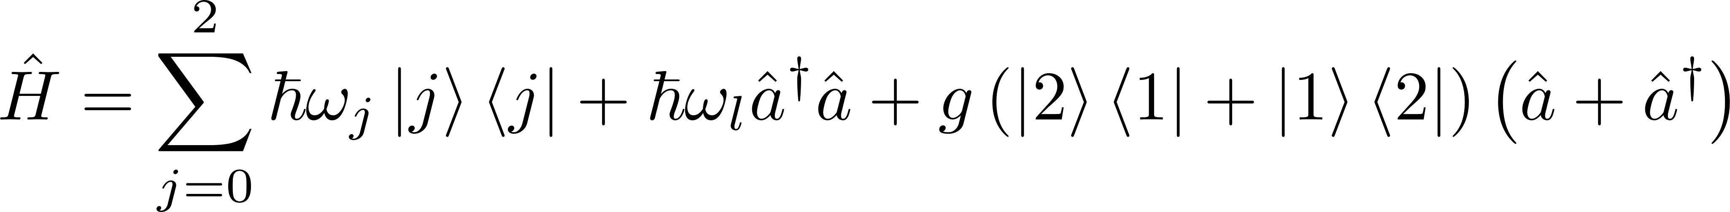
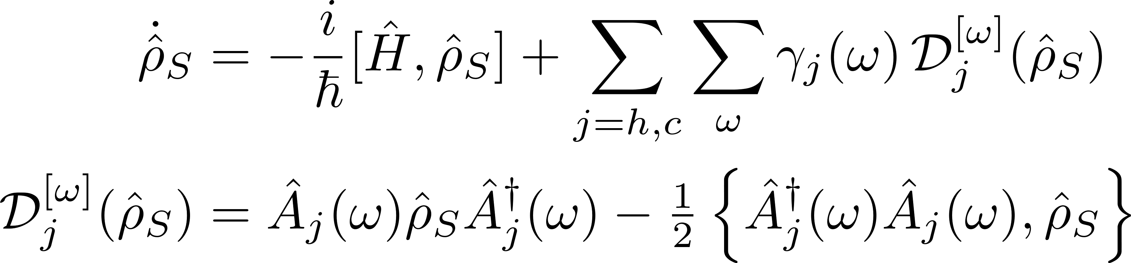
Global Master Equations For Finite Coupling

Slide 24
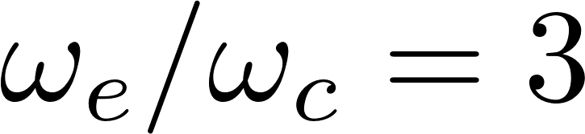
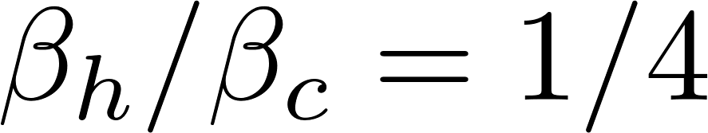
Finite Coupling → New Operation Regimes
Local Lindblad dynamics
Energy spacing of the last two levels:
Population inversion at:
First the local Lindblad phase space diagram.
Animate the four regimes coming out of coupling strength.
Emphasise they exist even at small values of g, and we missed it the whole time.
Show the power and heat currents showing how they engine -> ref contains accelerators and heaters.

Slide 25
Finite Coupling → New Operation Regimes
Global Lindblad dynamics
Accelerators and heaters emerge from
Engine suppressed, refrigerator disappears
at large

Slide 26
Finite Coupling → New Operation Regimes
Emphasise they exist even at small values of g, and we missed it the whole time.

Slide 27
Bosonic Load Back-action

Slide 28
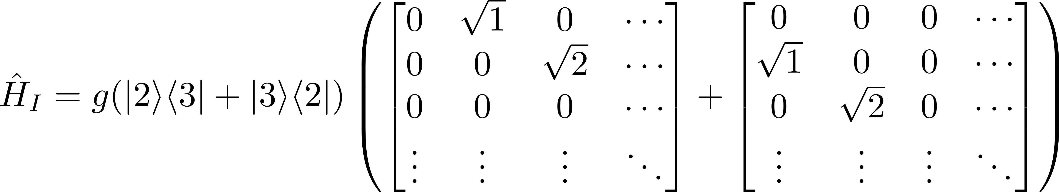
Bosonic Load Back-action

Slide 29
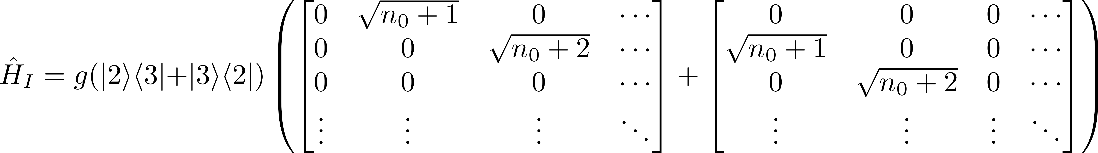
Bosonic Load Back-action

Slide 30
Bosonic Load Back-action

Slide 31
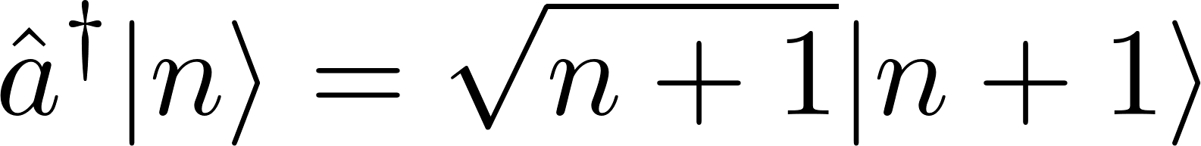
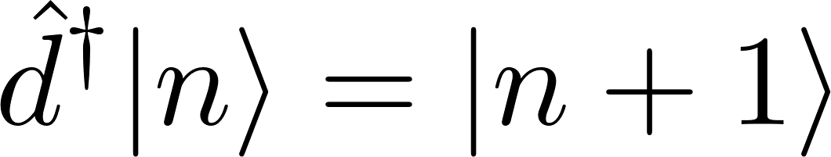
Bosonic Load Back-action
(a)
Initialising the load to a higher level effectively increases the coupling strength.
Offsetting the load causes crossover to the other thermal operations.
(b)
The effect of offset is not present in the ladder load. No crossover.
The four modes of thermal operation is still present in it.

Slide 32
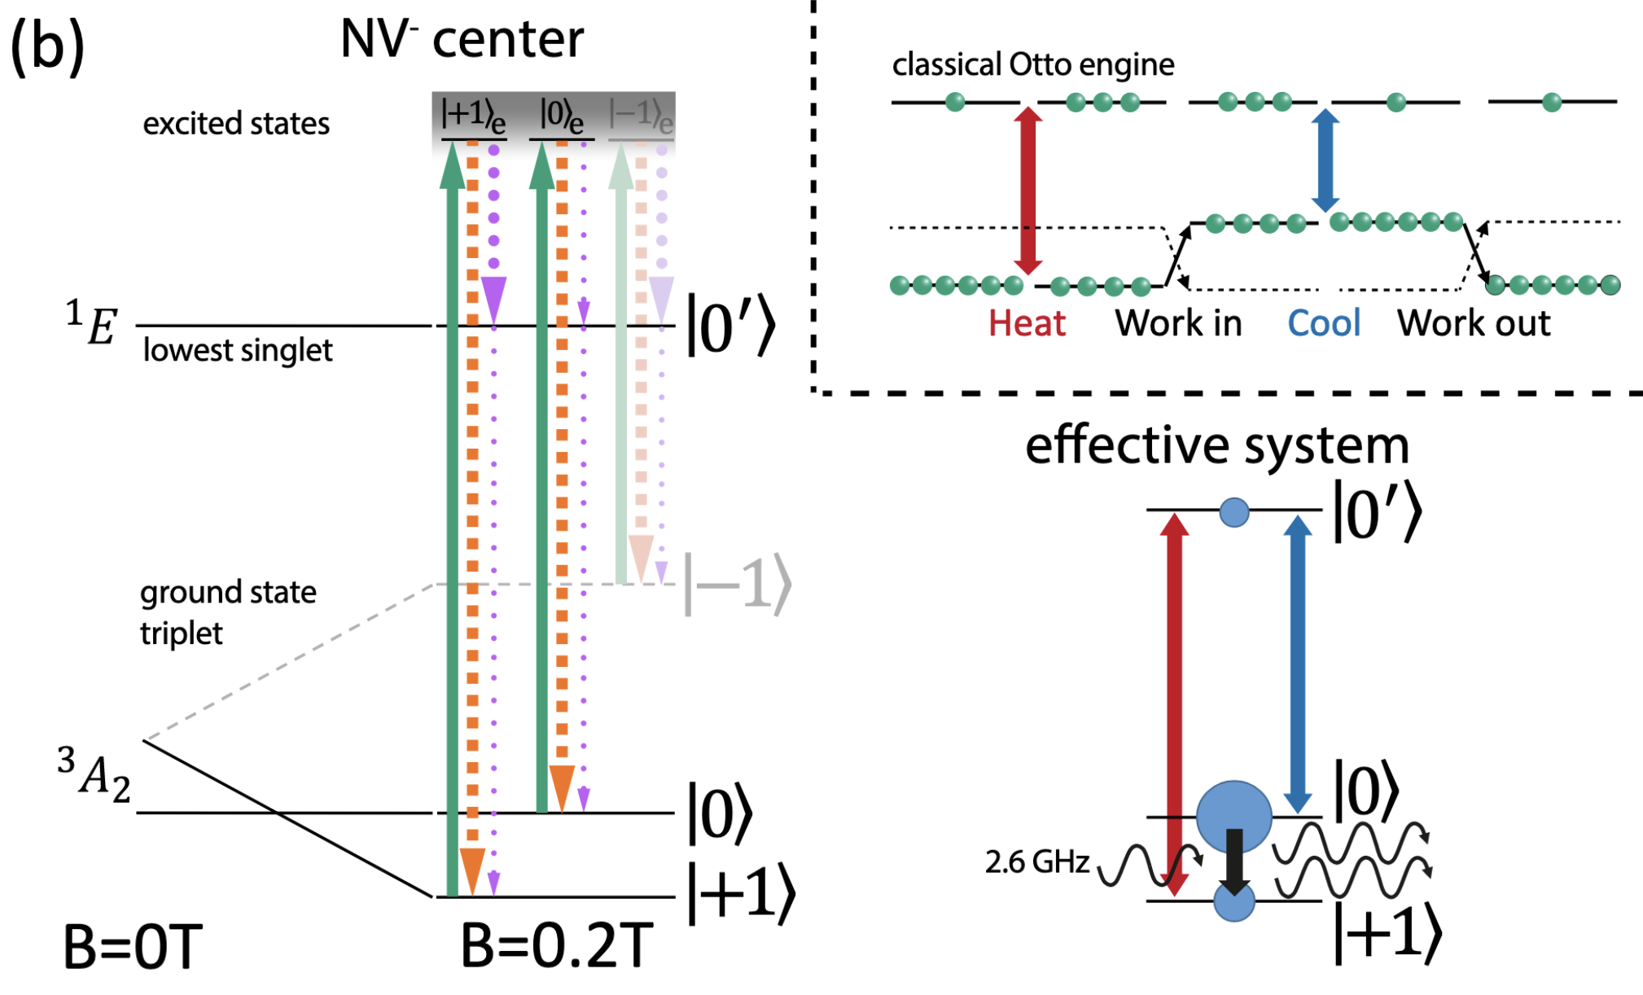
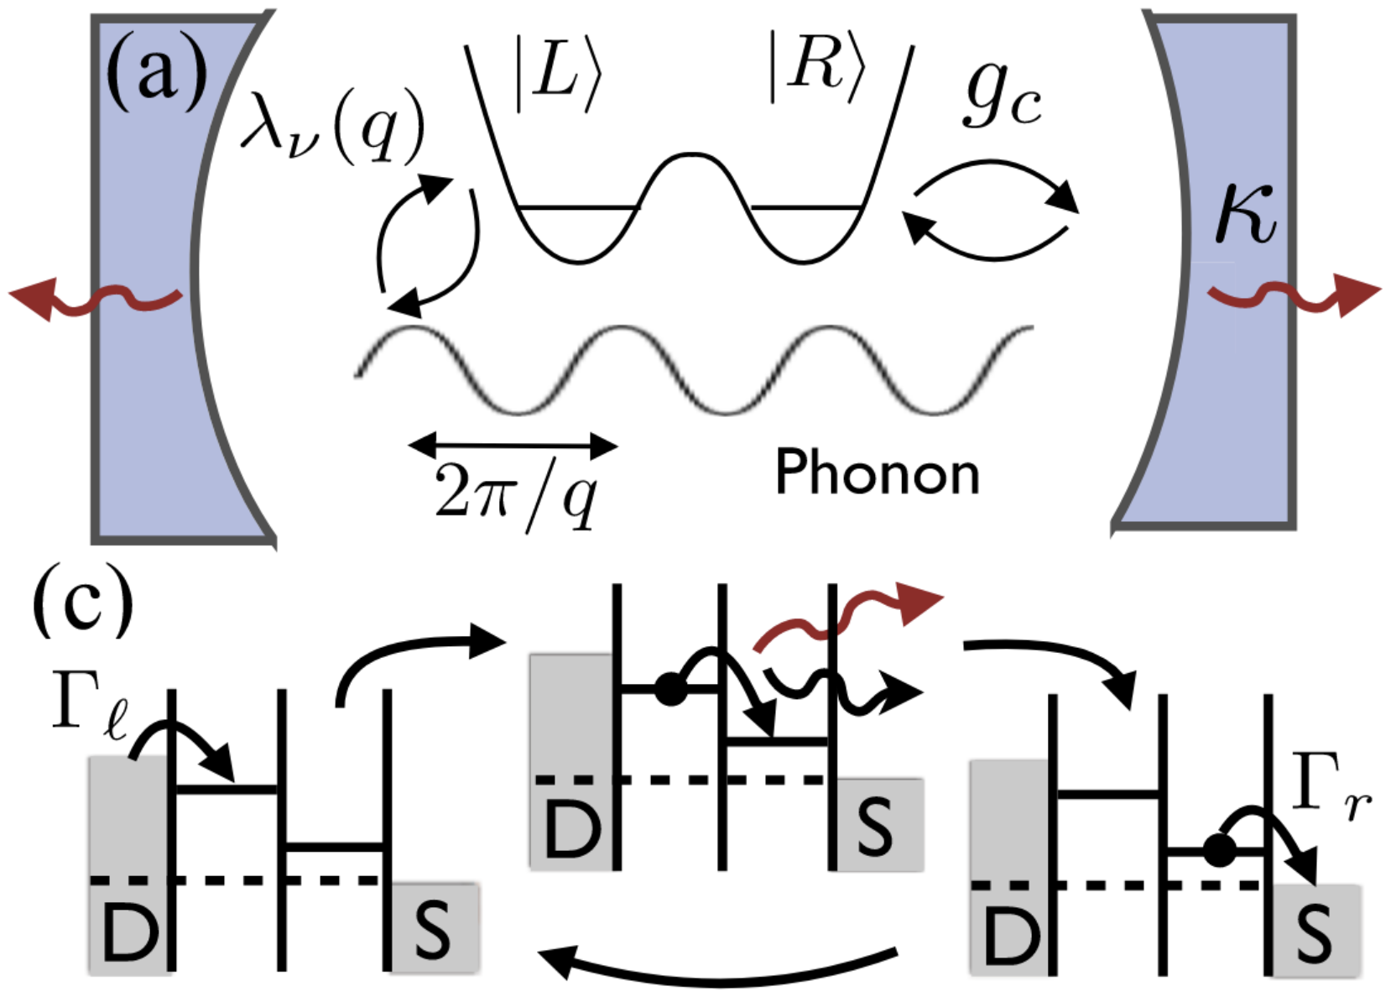
Experimental Platforms:
Three-level Thermal Machine
Has a closer structure to a three-level system coupled to a bosonic cavity.
Tunable coupling strength.
Engineer electron reservoir baths to model bosonic baths?
Can generate three-body interaction terms?
Continuous time-independent versions already realized.
Natural bosonic load with tunable coupling strength?
Tunable thermal baths’ temperature?
Klatzow et al., Phys. Rev. Lett. 122, 110601 (2019)
Gullans et al., Phys. Rev. Lett. 114, 196802 (2015)

Slide 33
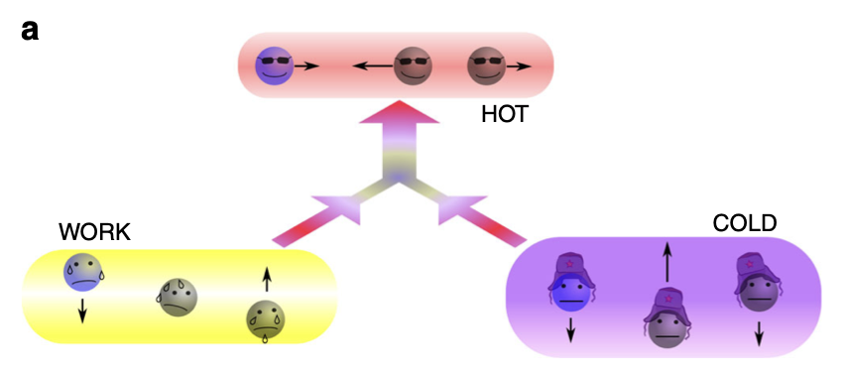
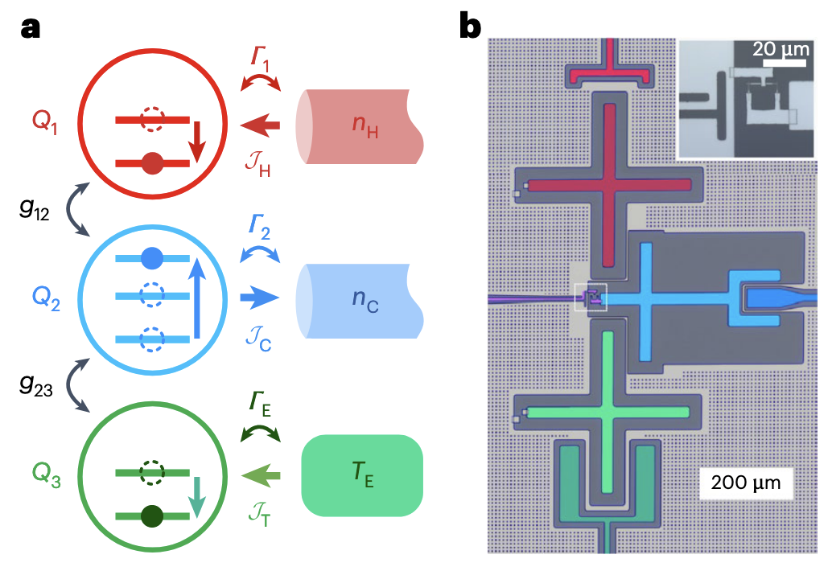
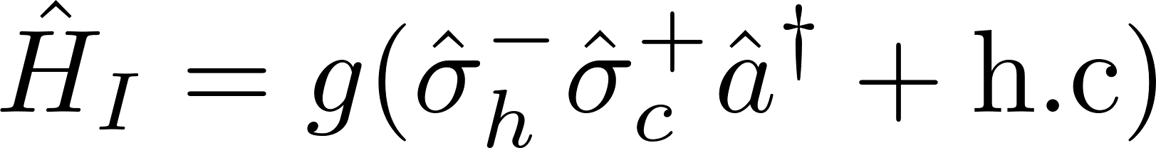
Experimental Platforms:
Two-qubit Thermal Machine
Can engineer thermal baths using series of LC oscillators.
Can use two Transmon qubits coupled to an LC oscillator to model our thermal machine.
Possible to generate Fock states in the load.
Slightly tricky to engineer three-body interactions using sideband transitions.
Can engineer three-body interactions through sideband transitions.
Can couple internal configurations with the phononic modes of the trapped ions.
No natural “thermal bath” without synthetically generating laser pulses.
Maslennikov et al., Nat. Commun. 10, 202 (2019)
Aamir et al., Nat. Phys. 20, 1012 (2024)

Slide 34
Summary And Outlook
Beyond local master equation: Finite coupling gives rise to richer thermodynamic operations.
Four modes of operation exist even at weak coupling: A fundamental effect that arises in autonomous thermal machines.
Demonstration of a purely quantum back-action: Bosonic enhancement factor of the load changes the effective coupling strength.
Experimental implementation on a superconducting platform.
What is the boundary between small, finite, and strong coupling? When does the typical behavior deviate from biased diffusion?
Is the same effect observed on other loads? Also in classical nanoscopic systems?

Slide 35
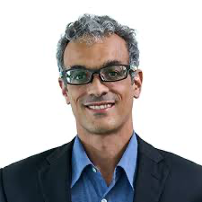
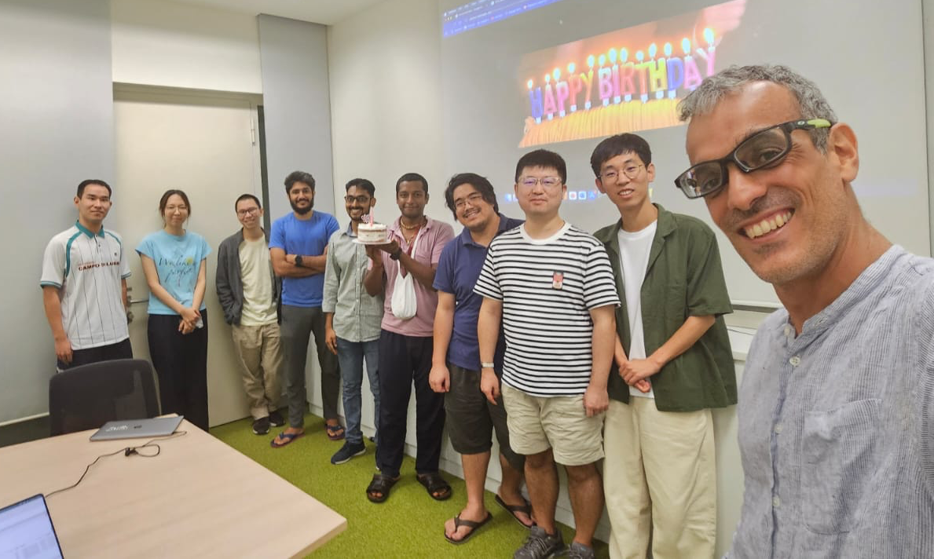



Acknowledgements
https://arxiv.org/abs/2506.01852
Referee 1 of our manuscript
😌🙏🏻
Andre Eckardt, Raam Uzdin, Kishore Bharati, David Aghamalyan
PRA Letter link
https://doi.org/10.1103/dr9b-5ryh

